Slide 1
SPRING CLOUD CONFIG SERVER
We will set up a Config Server and then build a client application that consumes the configuration on startup and then refreshes the configuration without restarting.
The application we are building is the same “Hello World” application discussed in the Centralized Configuration Getting Started Guide, but we go into more depth about the concepts of Spring Cloud Config Server in this article.
The full source code for the tutorial is on GitHub.

Slide 2
What Is Spring Cloud Config Server?
” As the documentation succinctly states, “Spring Cloud Config provides server and client-side support for externalized configuration in a distributed system.”
The default implementation of the server storage backend uses git, so it supports labeled versions of configuration environments with ease and is accessible to many tools for managing the content.
Spring Cloud Config fits very well into Spring applications because its concepts of both client and server map precisely to the Spring Environment and PropertySource abstractions. However, Spring Cloud Config can be used with any application running in any language.

Slide 3
Create a Multi-Module Project
The application we are creating will have two modules:
one for the Configuration Service and the other for the Configuration client.
Because of this, we need to create a parent pom.
Parent
In our IDE, let’s create a new project. I’m using Spring Tool Suite, but that’s just a personal preference.
In our pom.xml, let’s specify our two modules:

Slide 4
Sample code
<?xml version="1.0" encoding="UTF-8"?>
<project xmlns="http://maven.apache.org/POM/4.0.0" xmlns:xsi="http://www.w3.org/2001/XMLSchema-instance" xsi:schemaLocation="http://maven.apache.org/POM/4.0.0 http://maven.apache.org/xsd/maven-4.0.0.xsd">
<modelVersion>4.0.0</modelVersion>
<groupId>com.michaelcgood</groupId>
<artifactId>com.michaelcgood</artifactId>
<version>0.0.1</version>
<packaging>pom</packaging>
<name>michaelcgood-spring-cloud-config-server</name>
<description>Intro to Spring Cloud Config Server</description>
<modules>
<module>mcg-configuration-client</module>
<module>mcg-configuration-service</module>
</modules>
</project>

Slide 5
Configuration Service
In our IDE, let’s create a new Maven module for our configuration service and insert this in our pom:
Configuration Client
Now we just need to make a module for our configuration client. So, let’s make another Maven module and insert this into our POM:

Slide 6
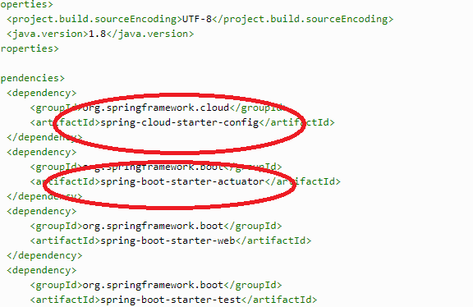

Slide 7
Config Server
Now we will create a Config Service to act as an intermediary between our client and a git repository.
Enable Config Server
We use Spring Cloud’s @EnableConfigServer to create a config server that can be communicated with. So, this is just a normal Spring Boot application with one annotation added to enable the Config Server.:

Slide 8
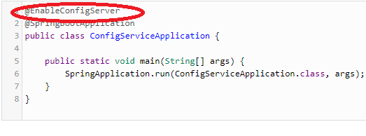

application.properties
To ensure that there is no conflict between config Service and client, we specify a different port for the Config Service:

Slide 9

The second line spring.cloud.config.server.git.uri=${HOME}/Desktop/mcg-config points to a git repository, which we will create next.
Git:
On a *nix system, we can do everything on the command line.
We make a folder on our desktop:

Slide 10


We create a file named a-bootiful-client.properties using vim:
We add the message, “Hello World” but this could be whatever we would like. After we write (:w) we quit (:q) vim.
Now let’s create a new repo:

Slide 11


Now we add the file that contains our message:
Let’s commit:
Configuration Client
Now let’s create a new Spring Boot application that uses the Config Server to load its own configuration and that refreshes its configuration to reflect changes to the Config Server on-demand, without restarting the JVM.
Spring will see the configuration property files just like it would any property file loaded from application.properties, application.yml or any other PropertySource.

Slide 12
Reflecting Changes:
The client may access any value in the Config Server using the standard Spring ways, such as @ConfigurationProperties or @Value(“${…}”).
With this in mind, we create a REST controller that returns the resolved message property’s value:
The default configuration only allows the values to be read on the client’s startup and not again.
So, using @RefreshScope we force the bean to refresh its configuration, which means it will pull updated values from the Config Server, and then trigger a refresh event.

Slide 13
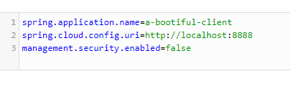
bootstrap.properties:
The properties to configure the Config Client must be read in before the rest of the application’s configuration is read from the Config Server, during the bootstrap phase.
We specify the client’s spring.application.name and the location of the Config Server spring.cloud.config.uri:

Slide 14

Note: We disabled security with our setting management.security.enabled=false to make testing and tinkering easy for us.
Demo:
First, we need to change directory to our configuration service and start it:
And then do the same for our client:
We can see in our terminal for configuration service when the a-bootiful-client.properties is added:

Slide 15

Let’s open our browser and visit http://localhost:8080/message. We see “Hello World”.
Now let’s change the message in a-bootiful-client.properties again and this time put, “Hi! :-)”.
After saving and doing a commit, we visit http://localhost:8888/a-bootiful-client/default to confirm our change.
Now we invoke the Spring Boot Actuator refersh endpoint to refresh our client:
We visit http://localhost:8080/message and see our message “Hi! :-)” is displayed.
For more information on Spring Boot Actuator, see the tutorial Building Spring Boot RESTful Service + Spring Boot Actuator.

Slide 16
Conclusion:
We just completed centralizing configuration of our services in Spring. We accomplished this by standing up a Spring Cloud Config Server and creating a client to consume the configuration on startup and then refresh the configuration without restarting.
Many other things can be done with Spring Cloud Config Server that we did not touch on, such as:
Have the Config Server register with the Discovery Service for Spring Cloud Netflix, Eureka Service Discovery or Spring Cloud Consul
Serve configuration in YAML or Properties format
Serve plain text configuration files
Embed the config server in an application
The full source code can be found on GitHub.

Slide 17
2.1.3 JDBC back end
Spring Cloud Config Server supports JDBC (relational database) as a backend for configuration properties.
You can enable this feature by adding spring-jdbc to the classpath and using the jdbc profile or by adding a bean of type JdbcEnvironmentRepository.
If you include the right dependencies on the classpath (see the user guide for more details on that), Spring Boot configures a data source.
The database needs to have a table called PROPERTIES with columns called APPLICATION, PROFILE, and LABEL (with the usual Environment meaning), plus KEYand VALUE for the key and value pairs in Properties style. All fields are of type String in Java, so you can make them VARCHAR of whatever length you need.
Property values behave in the same way as they would if they came from Spring Boot properties files named {application}-{profile}.properties, including all the encryption and decryption, which will be applied as post-processing steps (that is, not in the repository implementation directly)

Slide 18
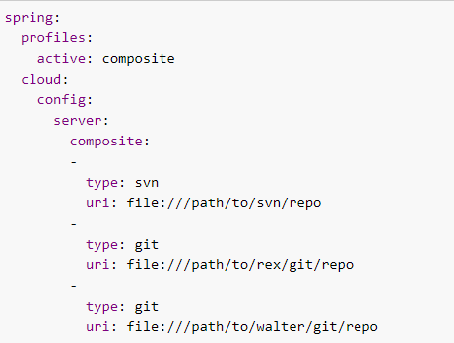
2.1.8 composite environment repositories
In some scenarios, you may wish to pull configuration data from multiple environment repositories.
To do so, you can enable the composite profile in your configuration server’s application properties or YAML file.
If, for example, you want to pull configuration data from a Subversion repository as well as two Git repositories, you can set the following properties for your configuration server:

Slide 19
Using this configuration, precedence is determined by the order in which repositories are listed under the composite key.
In the above example, the Subversion repository is listed first, so a value found in the Subversion repository will override values found for the same property in one of the Git repositories.
A value found in the rex Git repository will be used before a value found for the same property in the walter Git repository.
If you want to pull configuration data only from repositories that are each of distinct types, you can enable the corresponding profiles, rather than the composite profile, in your configuration server’s application properties or YAML file.
If, for example, you want to pull configuration data from a single Git repository and a single HashiCorp Vault server, you can set the following properties for your configuration server:

Slide 20
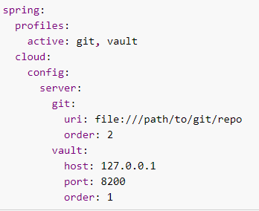
Using this configuration, precedence can be determined by an order property.
You can use the order property to specify the priority order for all your repositories. The lower the numerical value of the order property, the higher priority it has.
The priority order of a repository helps resolve any potential conflicts between repositories that contain values for the same properties.

Slide 21
If your composite environment includes a Vault server as in the previous example, you must include a Vault token in every request made to the configuration server. See Vault Backend.
Any type of failure when retrieving values from an environment repository results in a failure for the entire composite environment.
When using a composite environment, it is important that all repositories contain the same labels. If you have an environment similar to those in the preceding examples and you request configuration data with the master label but the Subversion repository does not contain a branch called master, the entire request fails.
.

Slide 22
Custom Composite Environment Repositories
In addition to using one of the environment repositories from Spring Cloud, you can also provide your own EnvironmentRepository bean to be included as part of a composite environment.
To do so, your bean must implement the EnvironmentRepository interface.
If you want to control the priority of your custom EnvironmentRepository within the composite environment, you should also implement the Ordered interface and override the getOrdered method.
If you do not implement the Ordered interface, your EnvironmentRepository is given the lowest priority.

Slide 23
2.1.1 JIT BACK END
The default implementation of EnvironmentRepository uses a Git backend, which is very convenient for managing upgrades and physical environments and for auditing changes. To change the location of the repository, you can set the spring.cloud.config.server.git.uri configuration property in the Config Server (for example in application.yml.
To scale the Config Server up and make it highly available, you need to have all instances of the server pointing to the same repository, so only a shared file system would work. Even in that case, it is better to use the ssh: protocol for a shared filesystem repository, so that the server can clone it and use a local working copy as a cache.
This repository implementation maps the {label} parameter of the HTTP resource to a git label (commit id, branch name, or tag).
If the git branch or tag name contains a slash (/), then the label in the HTTP URL should instead be specified with the special string (_) (to avoid ambiguity with other URL paths). For example, if the label is foo/bar, replacing the slash would result in the following label: foo(_)bar.
The inclusion of the special string (_) can also be applied to the {application}parameter. If you use a command-line client such as curl, be careful with the brackets in the URL — you should escape them from the shell with single quotes ('').

Slide 24
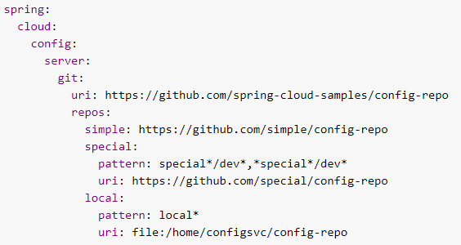
Pattern Matching and Multiple Repositories
Spring Cloud Config also includes support for more complex requirements with pattern matching on the application and profile name.
The pattern format is a comma-separated list of {application}/{profile} names with wildcards (note that a pattern beginning with a wildcard may need to be quoted), as shown in the following example:

Slide 25
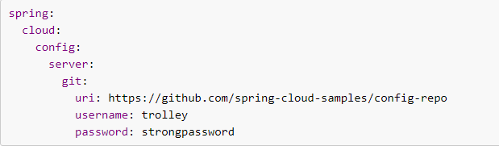
Authentication:
To use HTTP basic authentication on the remote repository, add the username and password properties separately (not in the URL), as shown in the following example:

Slide 26
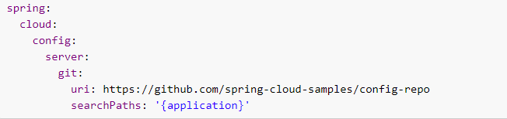
Placeholders in Git Search Paths:
Spring Cloud Config Server also supports a search path with placeholders for the {application} and {profile} (and {label} if you need it), as shown in the following example:

Slide 27
Force pull in Git Repositories:
As mentioned earlier, Spring Cloud Config Server makes a clone of the remote git repository in case the local copy gets dirty (for example, folder content changes by an OS process) such that Spring Cloud Config Server cannot update the local copy from remote repository.
To solve this issue, there is a force-pull property that makes Spring Cloud Config Server force pull from the remote repository if the local copy is dirty, as shown in the following example:

Slide 28
